Slide 1
Internet Concepts

Slide 2
Objective
Introduction to computer Networks
Categories of Computer Network
Different Types of Topologies
Client Server Concepts
Types of Network
WWW

Slide 3





Computer Network
A collection of computers interconnected to exchange information
Need for computer networks
  Intrinsically distributed information
  Resource sharing
  Computational power (load sharing)
  Reliability
Notes:
Computer Network: Interconnected Collection of computers. The devices such as printer, plotter, scanner, router, bridge, switch, hub are also part of a computer network

Slide 4
Connecting computers via a communication network
work station
mini
COMMUNICATION
NETWORK
microprocessor
general
purpose
Specific
purpose (DSP)
Expensive
Printer

Slide 5
Categories of Computer Networks
Computer Networks are classified based on the communication methods and size
Based on communication methods
  Broadcast communication networks
  Point-to-Point networks
Based on the size (scale)
  Local Area Networks (LAN)
  Metropolitan Area Networks (MAN)
  Wide Area Networks (WAN)
Notes:
Networks are classified based on the communication methods and size.
Based on the communication methods( transmission)
-Broadcast communication networks
-Point-to-Point networks
Based on the size (scale)
- Local Area Networks (LAN)
- Metropolitan Area Networks (MAN)
- Wide Area Networks (WAN)
Broadcast network:
Have a single communication channel which is shared by all the machines in the network
Many sites receive the short messages called packets and check the address field and process the packet if they are the intended recipients else they ignore it.
Can also address a packet to all destinations by using a special code in the address field.
Point-to-point network:
Consists of many connections between individual pairs of machines
In order to go from source to destination, a packet may have to go via a number of intermediate machines. Routing algorithms decide on the best route
.
LAN: This is a kind of network connecting systems in close physical proximity say in a single building or in a campus of upto a few kilometers in size.
LANs are thus restricted in size
LANs use a transmission technology usually consisting of a single cable to which all the machines are attached. Traditional LANs run at speeds of 10 to 100 Mbps or still higher.
Various topologies are possible for LANs like bus, ring etc
Common protocols used for LAN are Ethernet and Token Ring
MAN: This covers a city. Good example is cable TV network
WAN: This covers a larger geographical area and can span countries or continents.
They are not restricted in size
The speed is slower than in LAN
Internet

Slide 6
Network topology
Topology
  Refers to the way different sites are interconnected
Network Topology
  Refers to the way different computers are connected to each other
Motivation
  Given, let us say 100 computers, how to connect them?

Slide 7
Mesh/Completely connected Topology
Each node (computer/device) has a dedicated point-to-point link to every other node
One node can choose any path to another node based on the data traffic
To connect one node, in a network of ‘n’ nodes
‘(n(n-1))/2’ links are required
Notes:
Each node has a dedicated point-to-point link to every other node. The term complete connected means that one node can send packet to another node via many number of link. To connect a new node, in network of size n, it requires n-1 links. The total number of links is
n(n-1)/2

Slide 8

Star Topology
Each node (computer/device) has a dedicated point-to-point link to the central node
If one node wants to send packet to another, it sends the packet to the controller/switch, which then relays the packet to the other connected node
switch
Notes:
A central switch (or computer) is used to connect all computers in the network.

Slide 9
Ring Topology
Each node (computer/device) has a dedicated point-to-point link with the two nodes on either side of it
Data packet is passed along the ring in one direction, from one node to node, until it reaches its destination

Slide 10
Bus Topology
One long cable run as a backbone (bus) to link all the nodes in the network
nodes (computer/device) are connected to the bus by drop lines
Drop line
backbone
Terminator

Slide 11
Client Server Concepts

Slide 12
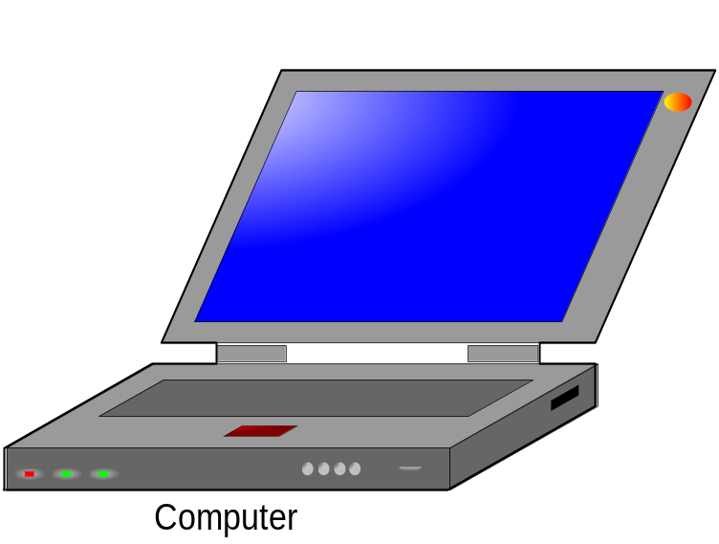
Evolution
Standalone – Single User
  Applications and Data reside on the same computer
  Dedicated for single user
  Powerful and economical
  Examples: Calculator, MS Word, etc
  Drawback
    Resources cannot be shared !!!
Notes:
Single user system computing is an approach that designs an application in such a way that all the applications and data reside on a single personal computer dedicated to the use of a single person.
Advantages
The advantages of using a stand-alone system are as follows.
1. A stand-alone system is considered to be a personal property. The user of the personal computer has a complete control of the working environment of the system. For example, if the user is not satisfied with MS-DOS operating system (OS), she can have Windows OS loaded in the system. If the person is not interested in the Windows OS then she can load Linux OS, and so on. Whatever the reason may be, the owner of the system has full authority to decide what she wants. In addition to the above-mentioned factors, third party applications are widely portable and usable in such systems. Thus, this serves as a good development environment.
2. Now a days, one can easily obtain powerful machines at a very cheap price.
Disadvantages
One of the major drawbacks in using stand-alone personal computers is that applications, data and resources, for example, cannot be shared.

Slide 13
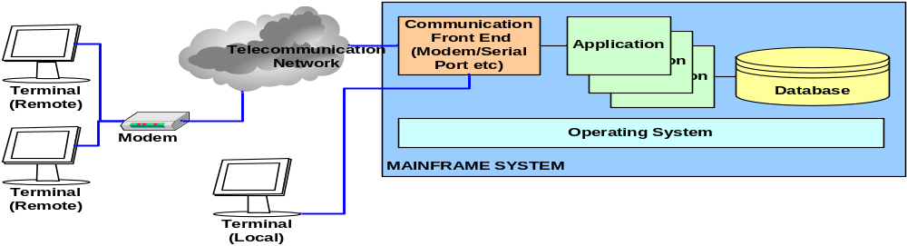
Evolution (Contd…)
Host Centric approach
  Applications and data components reside and execute on one centralized platform
  Multiple users access the same application on this central platform
    Examples: Mainframe
  Proprietary Technology
Notes:
Host based approach :
Host centric approach is an approach that design an application in such a way that both the functional and data components reside and execute on one centralized platform giving access to multiple users.
Advantages of Host Based approach
It is capable of providing simultaneous access to a very large number of users. The number of users accessing the system range from a few hundreds to few thousands.
These systems are stable, reliable and well supported.
Mainframe systems provide a one-stop-shopping which means that all the components right from hardware, software and network are made available by one vendor.
Limitation/Disadvantages of Host Based approach
Usually, mainframe technologies are proprietary and are incompatible across multiple vendors.
The cost associated with procuring and maintaining these systems are extremely high.

Slide 14
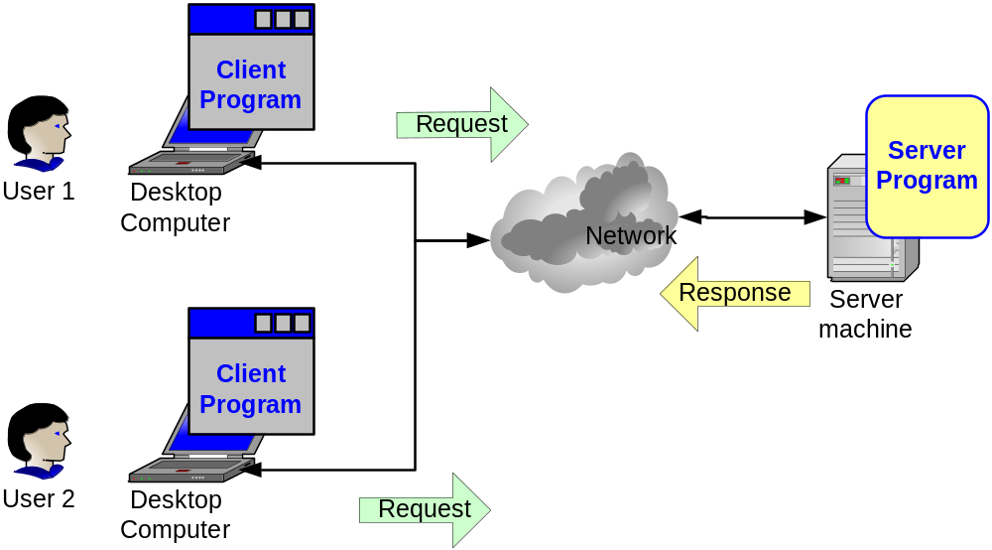
Client Server Architecture
Client/Server technology involves the client and server, both having processing capabilities.
The client request for a service and the server processes this request and sends a reply

Slide 15
Client Server Architecture (contd….)
Client
Makes requests
Server
- Responds to requests and provides services to clients

Slide 16
Features of a Client/Server system
Scalability:
  Scalability of a server or an application is the ability to provide service without degradation in performance as load increases
Client Server applications provide scope for scalability of application

Slide 17
Client Server Application - Layering
The Client Server Application can be split into 2 perspective
  Based on the functionality
    Presentation Logic
    Business Logic
    Data Source
  Based on the concentration of the functionality
    Fat Client / Thin Server
    Fat Server / Thin Client
Notes:
Its all about how you split the client/server applications into functional units that you can assign either to client or to one or more servers.

Slide 18
Client Server Application – Layering (contd…)
Based on the Concentration of Functionality
  Fat Client: Most of the application’s code resides on client side
  Fat Server: Most of the application’s code resides on the server side

Slide 19
Types of Network
Internet
Collection of networks
Intranet
An organisational network with features of internet
Extranet
- External to an organisational network, but linked to intranet.

Slide 20
Web Terminologies
Web Browser
Retrieving documents from Web, based on URL
Formatting and displaying the documents
Web page
Also called web document
A single element of a web site contained in one file on the disk

Slide 21
Web Terminologies (Contd..)
Web site
- Location on the web, publishing information
- A collection of one or more web pages
Web Server
- A computer on the internet or intranet that stores one or more web sites
- Responsible for replying to web browser requests for files

Slide 22
World Wide Web (www or web)
Global, interactive, dynamic, cross platform distributed, graphical hyper text information that runs over the internet
- Set of documents with little or no actual overall structure, each page is tied together by link

Slide 23
Thank you

